Slide 1

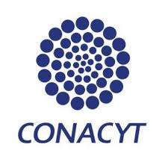
Fabrication of graphitic-carbon suspended nanowires through mechano-electrospinning of photo-crosslinkable polymers
Osamu Katagiri-Tanaka A01212611@itesm.mx
Principal Advisor: Dr. Héctor Alán Aguirre Soto Co-advisor and Director of Program: Dra. Dora Iliana Medina Medina
01 Sep 2020

Slide 2
Agenda
<a point for discussion> : <5min
<another point for discussion> : ~20min

Slide 3

Introduction: Carbon & Carbon Based Nanomaterials (CBNs)
The crystallite size, molecular arrangement, and anisotropy determine the material’s properties.
The interminable collection of CBNs range from soft, conductive lubricants to very hard, low conductivity solids; and from black colour, bulks to transparent, disordered thin films
R.L. McCreery, Advanced Carbon Electrode Materials for Molecular Electrochemistry, Chem. Rev. 108 (2008) 2646–2687. https://doi.org/10.1021/cr068076m.
S. Beigi-boroujeni, O. Katagiri-tanaka, B. Cardenas-benitez, O. Sergio, A. Aguirre-soto, Pyrolytic Carbon from Novolac Epoxy Resin Compressed before Photocrosslinking and Pyrolysis, Mater. Today Proc. (2020).

Slide 4
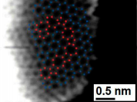
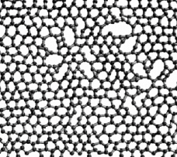
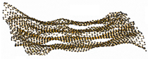
Introduction: Glass-like Carbon
Attractive for its electrochemical stability, thermal resistance, electrical conductivity, biocompatibility and is gas impermeable.
It is used in the manufacture of semiconductors.
R.L. McCreery, Advanced Carbon Electrode Materials for Molecular Electrochemistry, Chem. Rev. 108 (2008) 2646–2687. https://doi.org/10.1021/cr068076m.
G. Speranza, The Role of Functionalization in the Applications of Carbon Materials: An Overview, C — J. Carbon Res. 5 (2019) 84. https://doi.org/10.3390/c5040084.

Slide 5
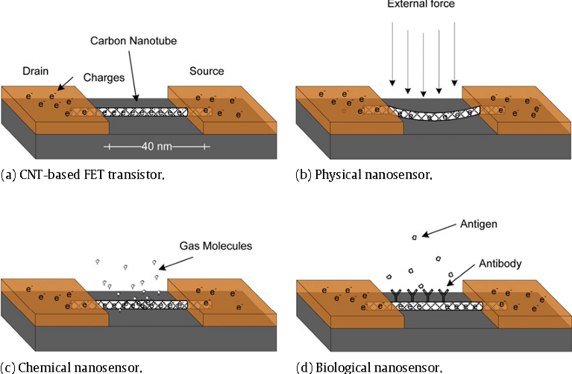
Glass-like Carbon NWs: Applications
R.L. McCreery, Advanced Carbon Electrode Materials for Molecular Electrochemistry, Chem. Rev. 108 (2008) 2646–2687. https://doi.org/10.1021/cr068076m.
G. Speranza, The Role of Functionalization in the Applications of Carbon Materials: An Overview, C — J. Carbon Res. 5 (2019) 84. https://doi.org/10.3390/c5040084.

Slide 6
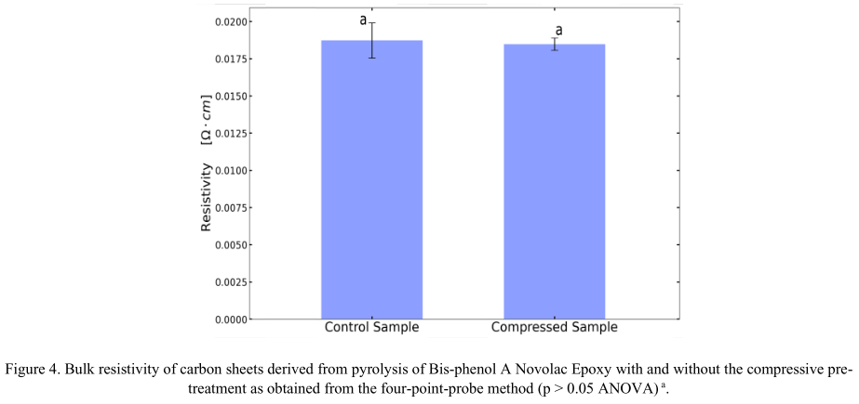
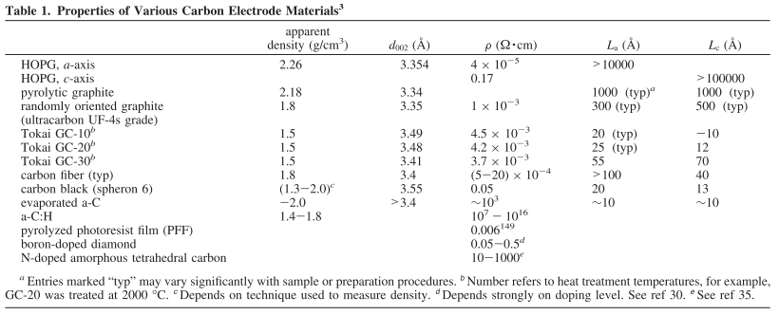
Introduction: MicroChem’s SU-8 & Tokai’s recipe
SU-8
glass-like carbon resistivity:
<content> <key concept>
R.L. McCreery, Advanced Carbon Electrode Materials for Molecular Electrochemistry, Chem. Rev. 108 (2008) 2646–2687. https://doi.org/10.1021/cr068076m.
G. Speranza, The Role of Functionalization in the Applications of Carbon Materials: An Overview, C — J. Carbon Res. 5 (2019) 84. https://doi.org/10.3390/c5040084.

Slide 7


Introduction: MicroChem’s SU-8 & Tokai’s recipe
SU-8
glass-like carbon resistivity:
Electrical resistivity – comparison:
highly oriented pyrolytic graphite (HOPG)
<
<
TOKAI Glassy carbon
SU-8 glass-like carbon
10^3
x4
<content> <key concept>
R.L. McCreery, Advanced Carbon Electrode Materials for Molecular Electrochemistry, Chem. Rev. 108 (2008) 2646–2687. https://doi.org/10.1021/cr068076m.
G. Speranza, The Role of Functionalization in the Applications of Carbon Materials: An Overview, C — J. Carbon Res. 5 (2019) 84. https://doi.org/10.3390/c5040084.

Slide 8

Introduction: Pyrolysis
Pyrolysis of SU8 is currently the typical method to produce glass-like carbon.
Polymer patterning through photolithography
Carbonization through pyrolysis
However, photolithography generates waste in the spin-coating and developing steps. Also, it presents physical & optical limitations to the carbon structures
Limitations can be overcome with other fabrication techniques …
Microchem, Su-8 2000.5-2015, 2000.5, 2002, 2005, 2007, 2010, 2015. (2006) 1–5. papers3://publication/uuid/859F51B9-0382-4DE8-88A9-267F936939A3.

Slide 9
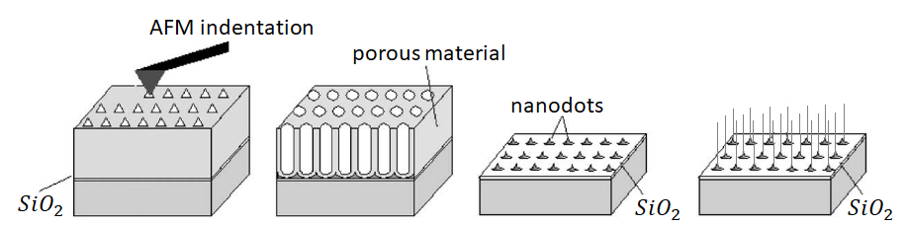
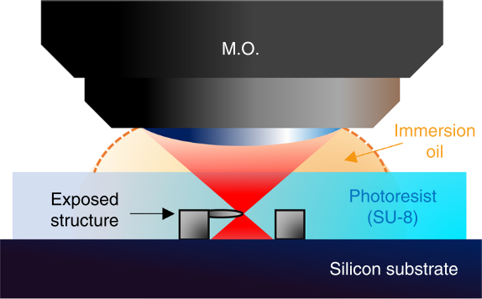
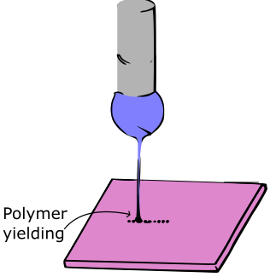
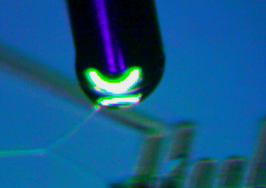
Current approaches
Self-assembly
Limited Length and Random Orientation
Two-Photon Polymerization (TPP)
Slow (mm per sec) & Expensive
* Near-Field Electrospinning (NFES)
Suspended Nanowires w/Spatial Control
V. Galstyan, M. Bhandari, V. Sberveglieri, G. Sberveglieri, E. Comini, Metal Oxide Nanostructures in Food Applications: Quality Control and Packaging, Chemosensors. 6 (2018) 16. https://doi.org/10.3390/chemosensors6020016.
D. Kluge, J.C. Singer, B.R. Neugirg, J.W. Neubauer, H.-W. Schmidt, A. Fery, Top–down meets bottom–up: A comparison of the mechanical properties of melt electrospun and self-assembled 1,3,5-benzenetrisamide fibers, Polymer (Guildf). 53 (2012) 5754–5759. https://doi.org/10.1016/j.polymer.2012.10.016.

Slide 10
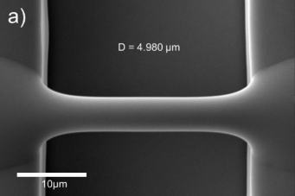
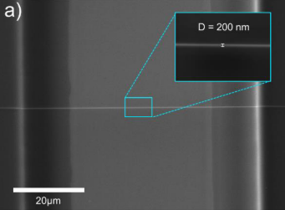
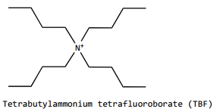
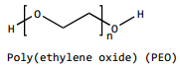
Best Results so far by NFES by Braulio & Ricardo
Fiber yield rate of 81 %
Fiber diameter before pyrolysis of 4.966 μm
Fiber diameter after pyrolysis of 204 nm
Fiber length of 60.5 ± 4.3 μm
Fiber resistance from 407 KΩ to 1.727 MΩ
wt% PEO 0.25 | SU-8 2002 [mg] | PEO [mg] | TBT [mg]
 | 2246 | 5.65 | 11.32
D.R. Flores, Role of rheological properties in near field electrospun fibers morphology, (2017) 130.
B. Cárdenas Benítez, Advanced Manufacturing Techniques for the Fabrication and Surface Modification of Carbon Nanowires, Tecnológico de Monterrey, 2017.

Slide 11
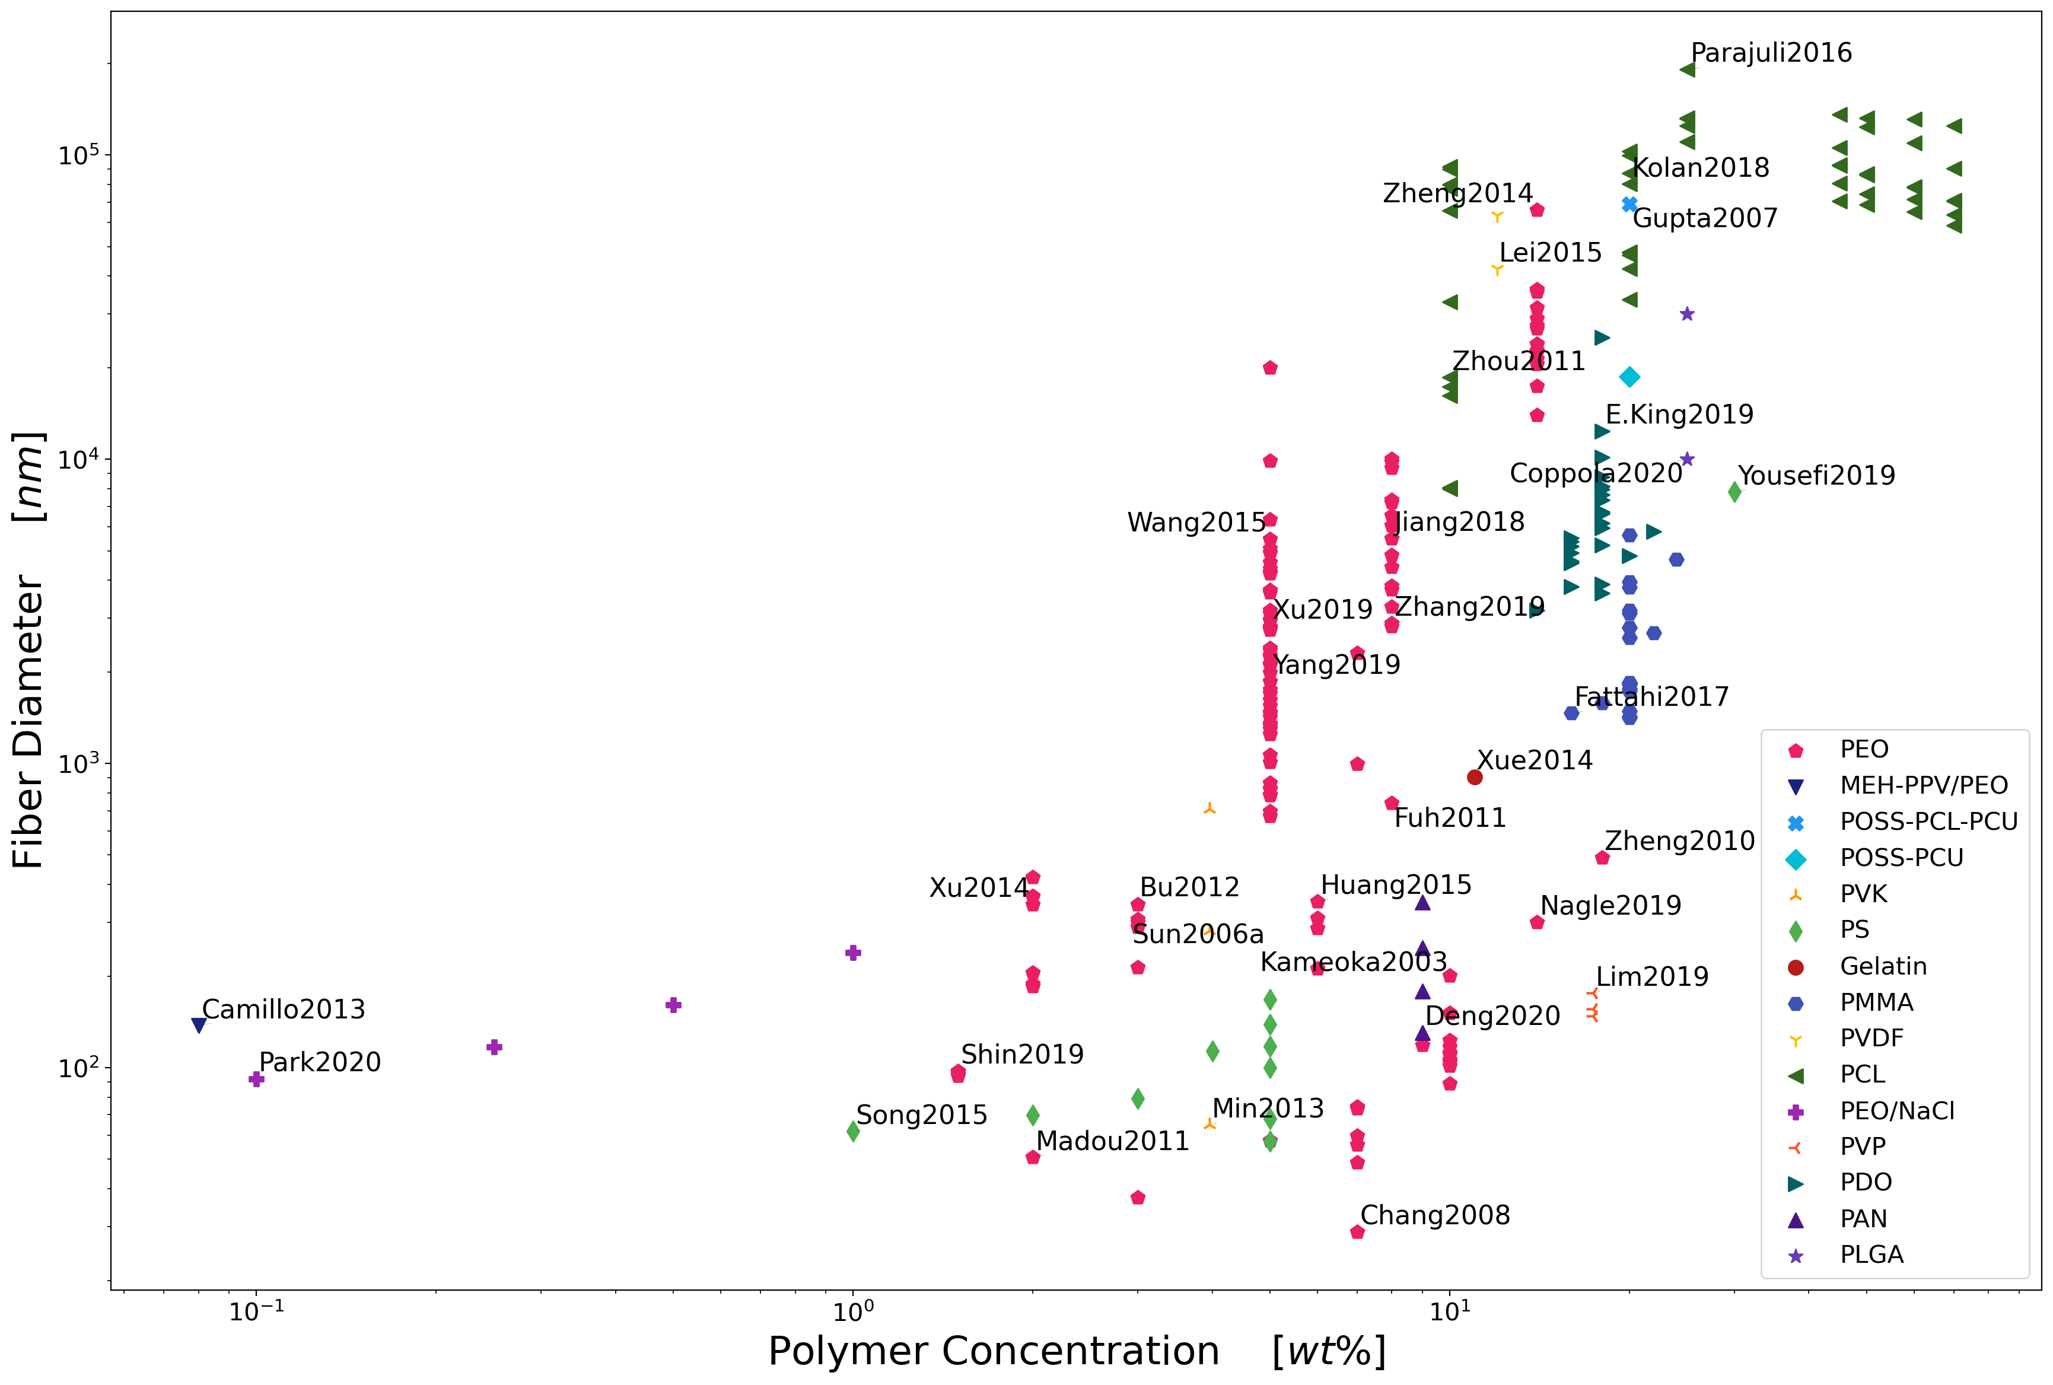
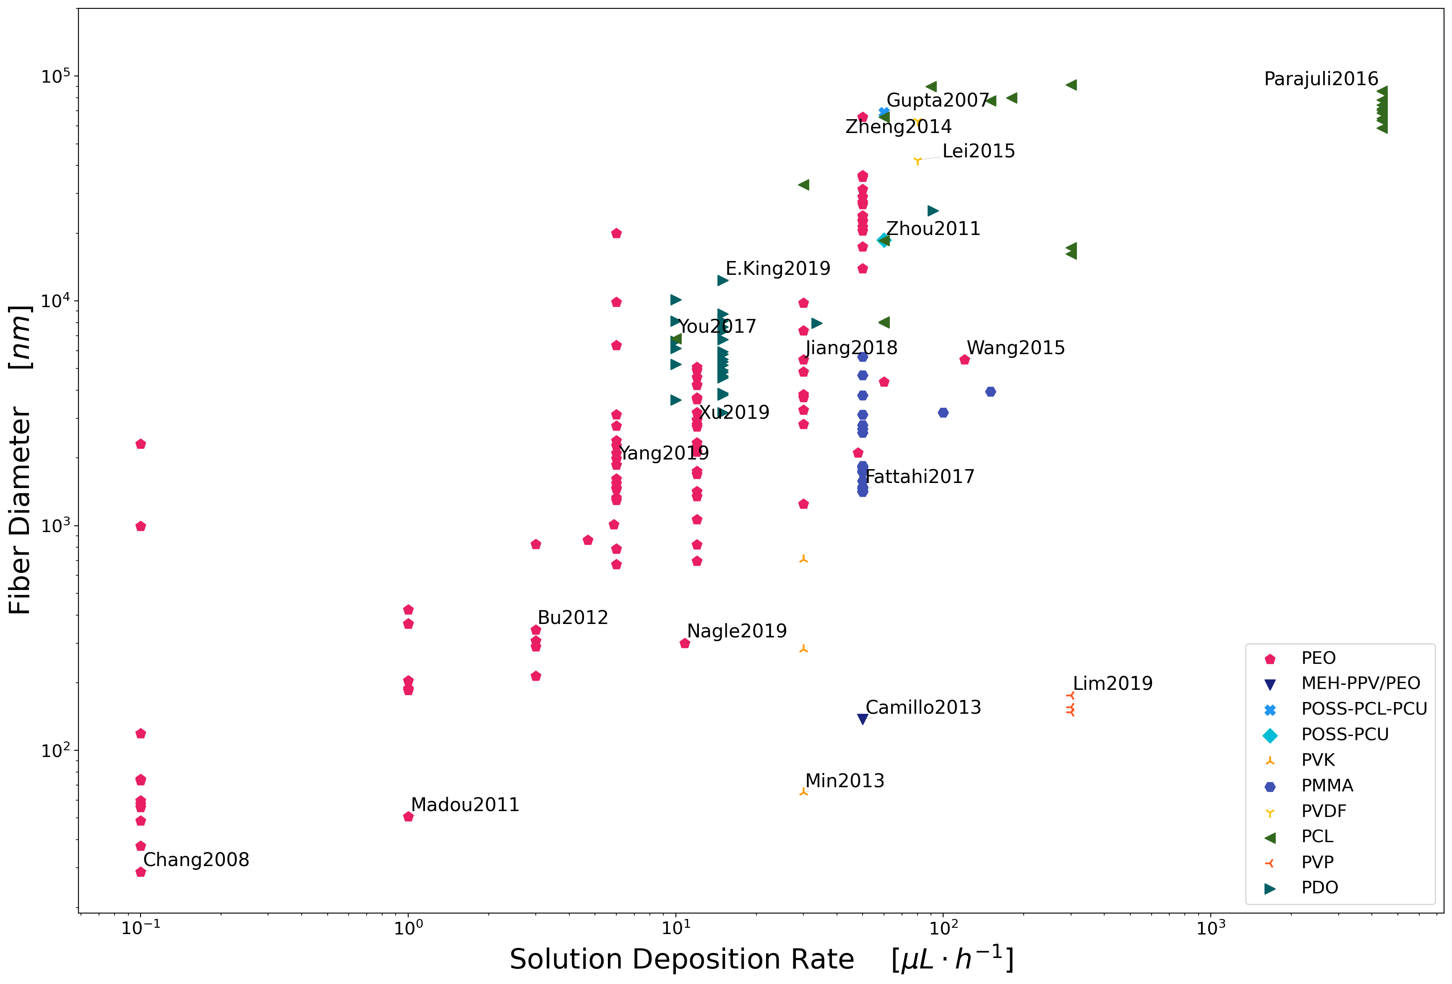
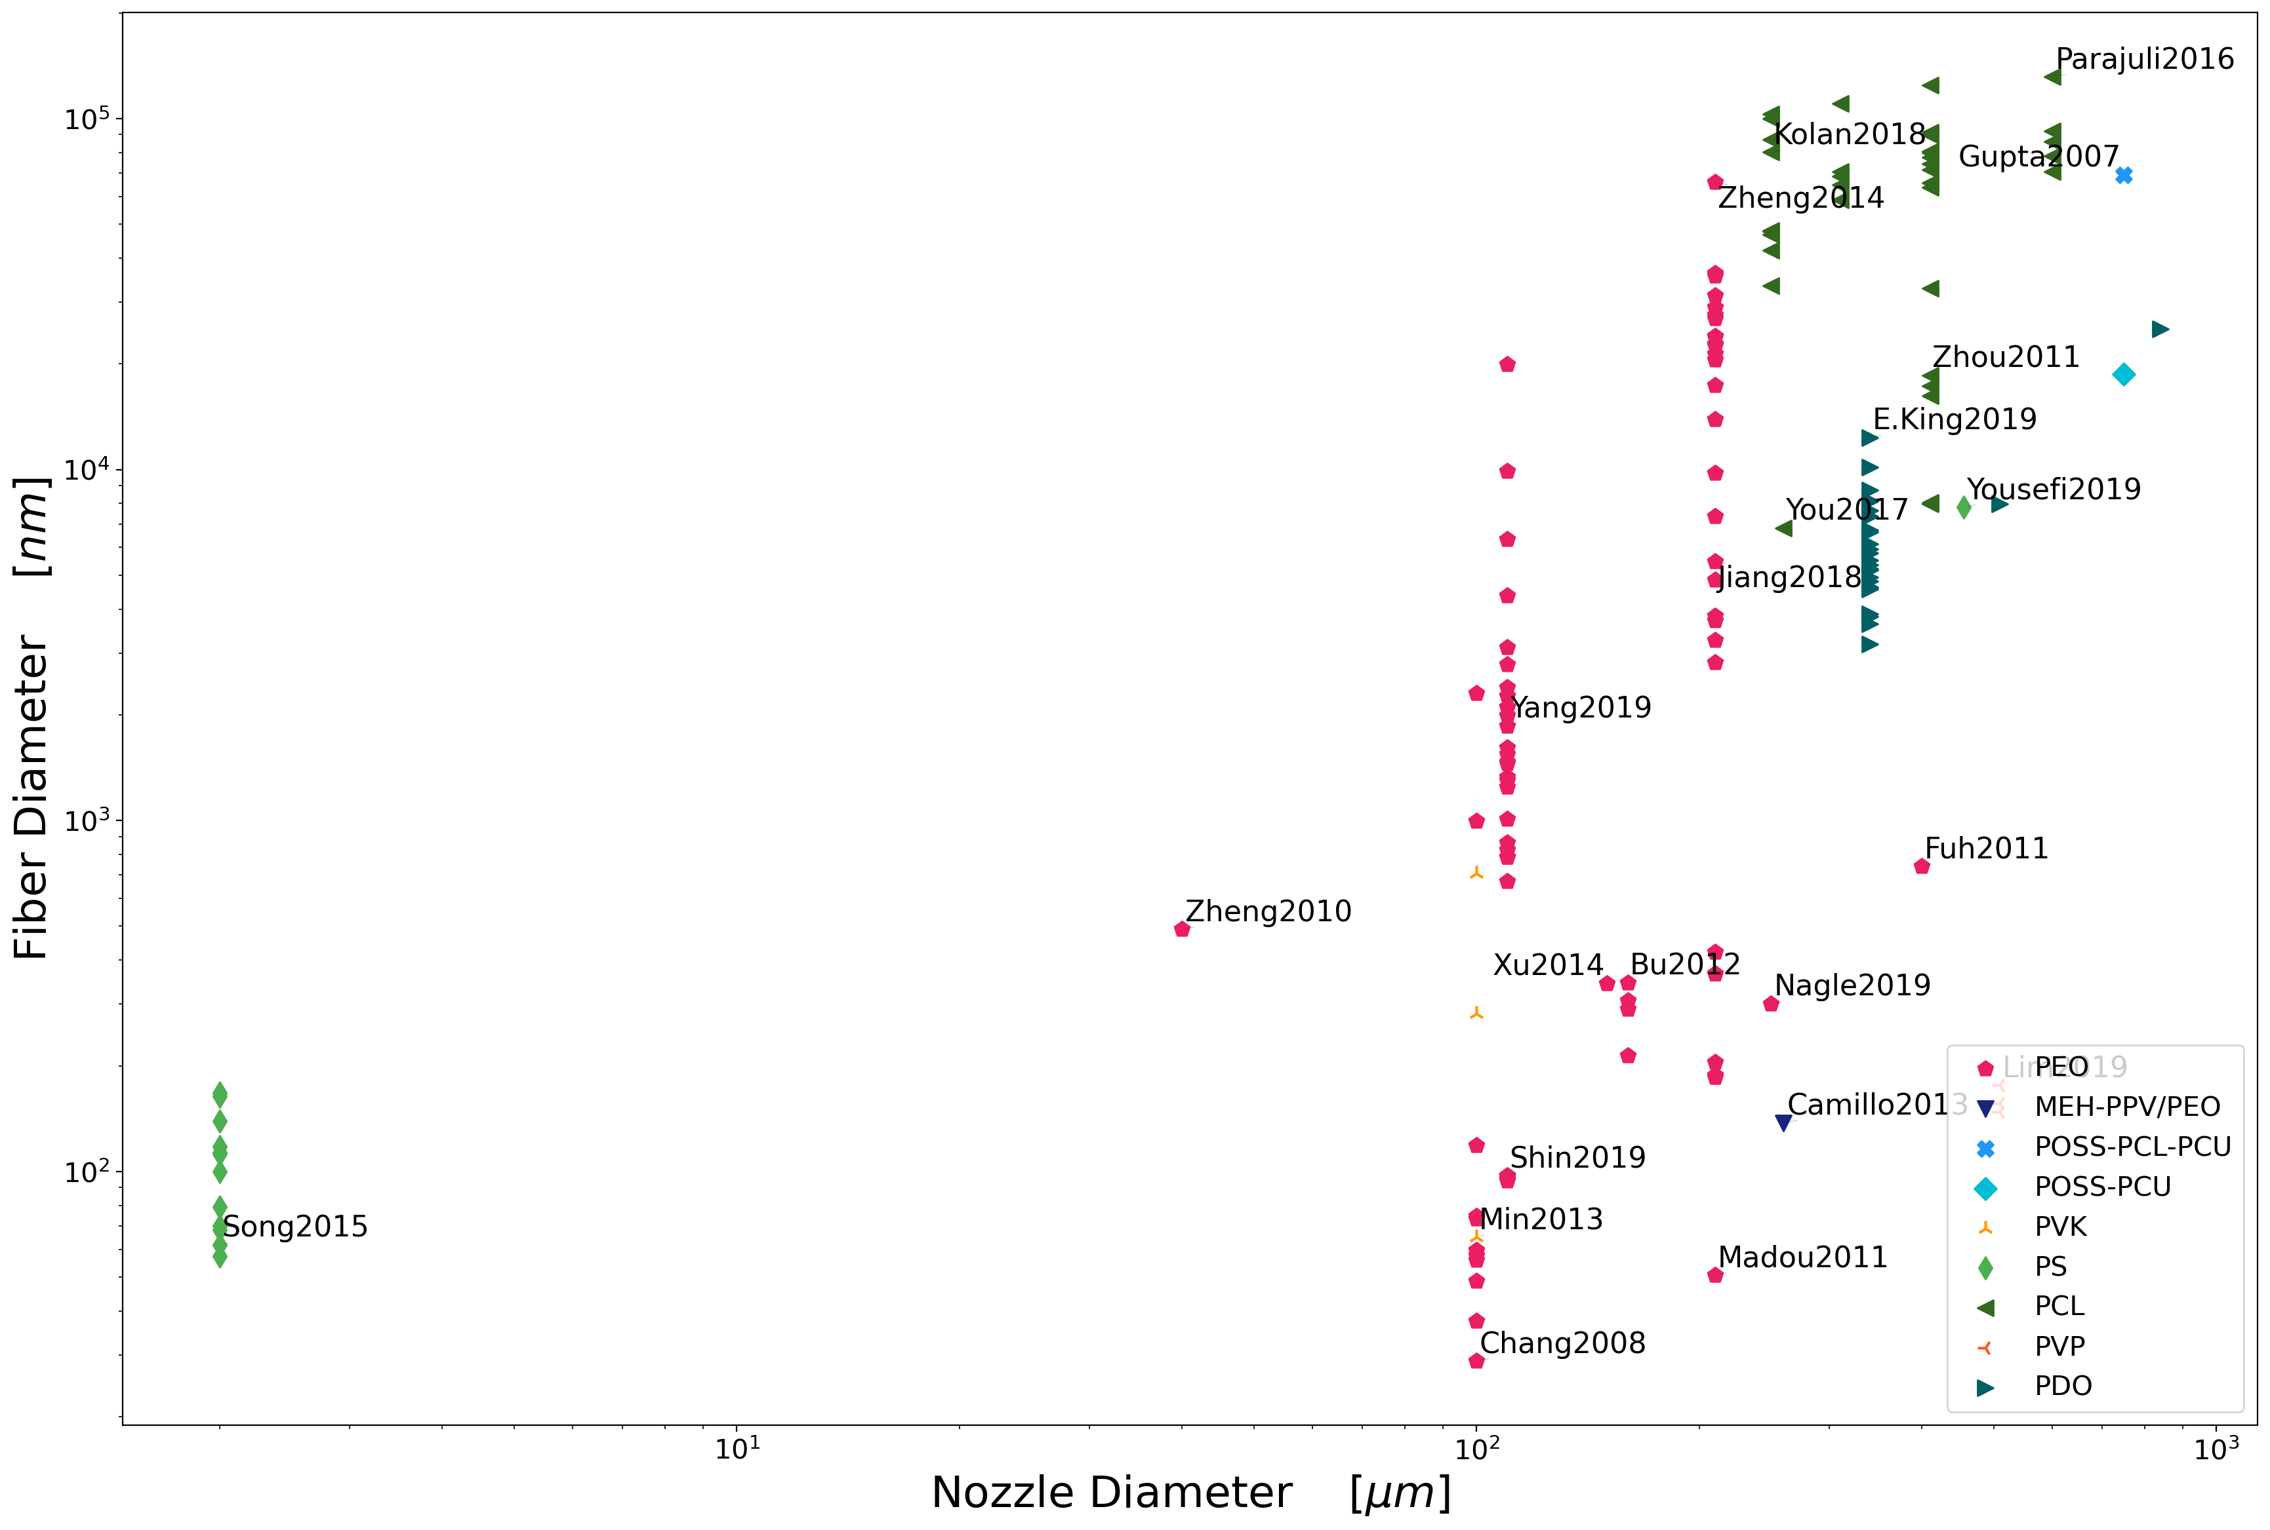
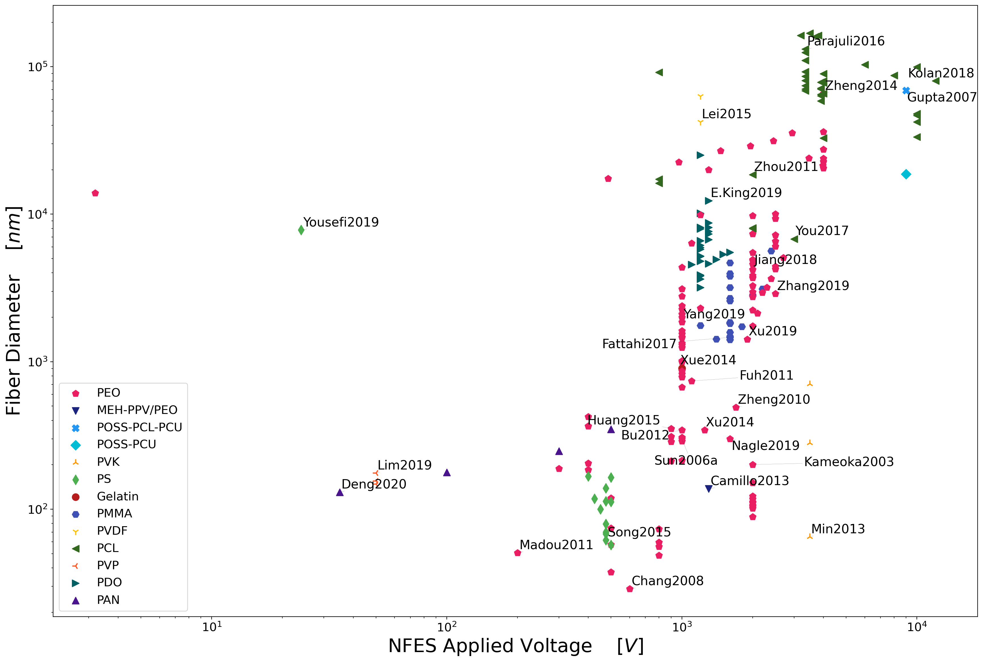
low polymer concentrations
slow solution deposition rates
NFES Literature Review : Process Parameters
small nozzle
diameters
low voltages
11

Slide 12
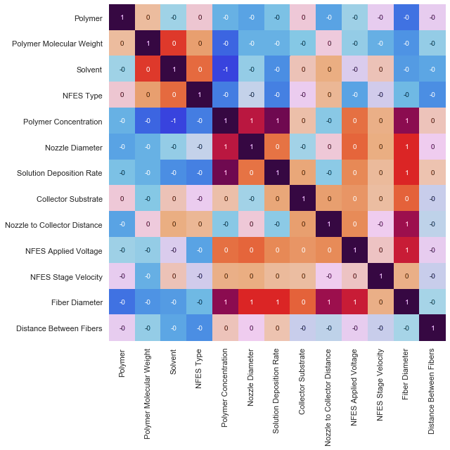
Polymer Concentration,
Nozzle Diameter,
Solution Deposition Rate,
Nozzle to Collector Distance &
Applied Voltage
are the main drivers of the final Fiber Diameter

Slide 13
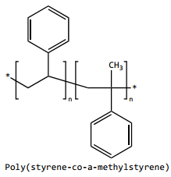
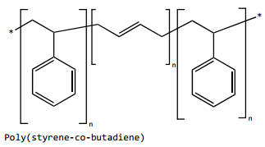
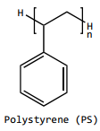
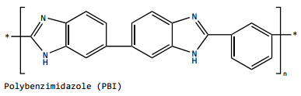
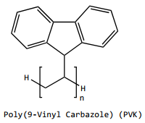
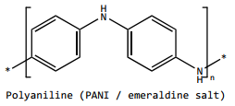
NFES Literature Review : Selection of Polymer-Solvent combinations:
Polymers with high carbon content relative to oxygen content
+15 wt% in DMF
~15 wt% in NMP ()
~25 wt% in THF & DMF (Fong1999)
30 wt% in THF (Yousefi2019)
~8 wt% in CHL
No records
No records
A.A. Yousefi, A.R. Mohebbi, S. Falahdoost Moghadam, S.A. Poursamar, L. Hao, Uniaxially aligned microwire networks for flexible transparent electrodes using a novel electrospinning set-up, Sol. Energy. 188 (2019) 1111–1117. ttps://doi.org/10.1016/j.solener.2019.07.007.
H. Fong, D.H. Reneker, Elastomeric nanofibers of styrene-butadiene-styrene triblock copolymer, J. Polym. Sci. Part B Polym. Phys. 37 (1999) 3488–3493. https://doi.org/10.1002/(SICI)1099-0488(19991215)37:24<3488::AID-POLB9>3.0.CO;2-M.

Slide 14
Implications of PEO, due to the introduction of oxygen
The fiber yield rate and fiber conductivity are impacted negatively.
Some samples are destroyed
during pyrolysis
High variance in the obtained conductivity across samples.
In the presence of oxygen, the char yield decreases. This is due to the oxidation on the char.

Slide 15
Conclusions:
<Conclusion A>
<Conclusion B>

Slide 16


Slide 17
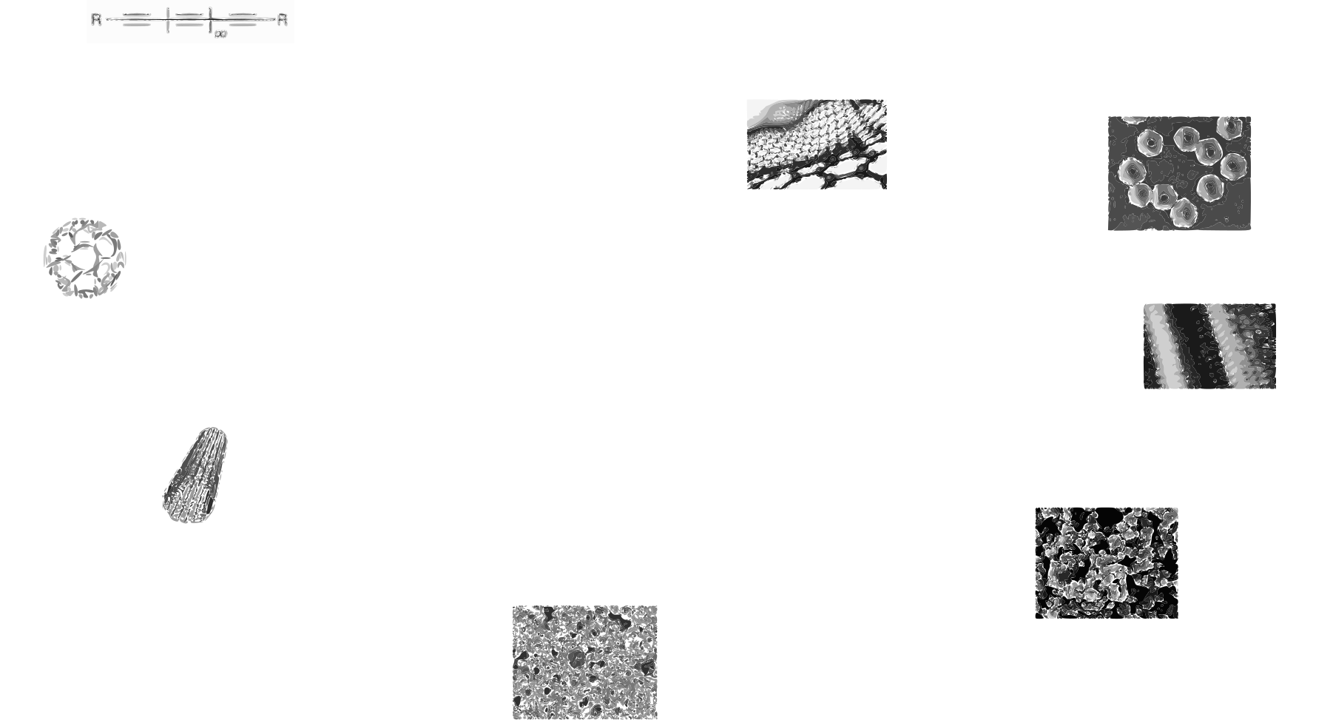
Side slide: Carbon allotropes
R.L. McCreery, Advanced Carbon Electrode Materials for Molecular Electrochemistry, Chem. Rev. 108 (2008) 2646–2687. https://doi.org/10.1021/cr068076m.
S. Beigi-boroujeni, O. Katagiri-tanaka, B. Cardenas-benitez, O. Sergio, A. Aguirre-soto, Pyrolytic Carbon from Novolac Epoxy Resin Compressed before Photocrosslinking and Pyrolysis, Mater. Today Proc. (2020).

Slide 18
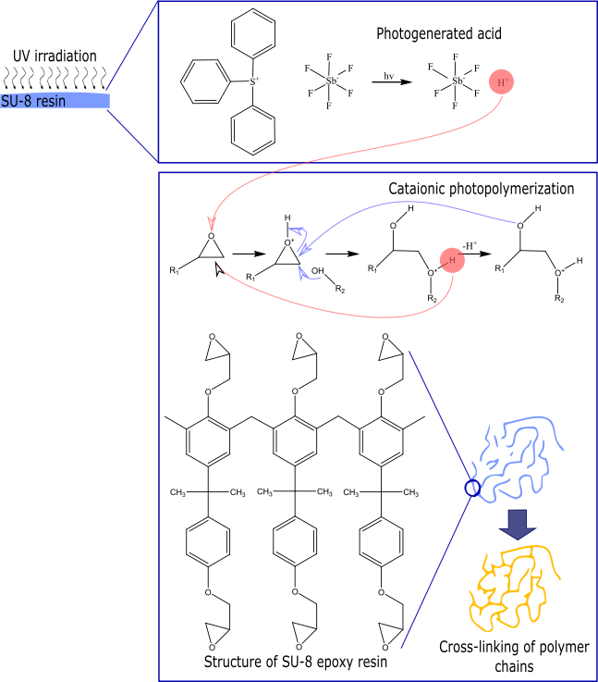
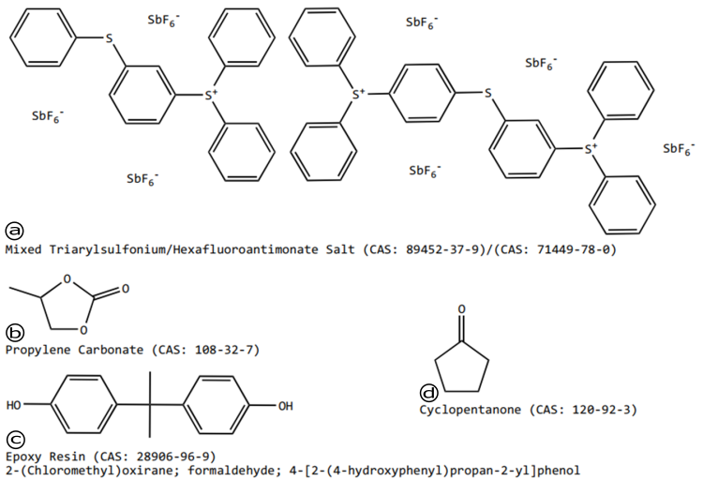
SU-8 (MicroChem, US)
Notes:
https://rsc.aux.eng.ufl.edu/_files/msds/309.pdf

Slide 19
Conclusions:
<content> <key concept> <key concept>

Slide 20
References
<reference A>
<reference B>

